Slide 1
USED CARS PRICE PREDICTION

Slide 2

USED CARS PRICE PREDICTION
Mini Project presentation
Master Of Computer Applications (MCA)
Submitted by
M MURALI KRISHNA
Reg. No : 322203320038
Under the guidance of
Dr. N . Jaya Lakshmi
Associate Professor
Department Of Computer Applications
DEPARTMENT OF COMPUTER APPLICATIONS
GAYATRI VIDYA PARISHAD COLLEGE OF ENGINEERING (AUTONOMOUS)
(Affiliated to J.N.T. University, Kakinada, A.P)
2022-2024

Slide 3
OUTLINES OF THE PRESENTATION
ABSTRACT
PROBLEM STATEMENT
EXISTING SYSTEM
PROPOSED SYSTEM
SYSTEM REQUIREMENTS
ARCHITECTURE
ALGORITHM
SAMPLE CODE
WEBPAGE PREVIEW
FINAL OUTPUT
CONCLUSION

Slide 4
ABSTRACT:
Everyone has a dream to buy a new car . But they cannot afford to buy a new car at that time he wants to buy a used cars . They do not have a knowledge to predict the price of a car . At that time this project will be helpful to predict the car selling price based on their features like the car model, the number of years that a car is old, the type of fuel it uses, the type of seller, the type of transmission and the number of kilometers that the car has driven so far. This project will help to get an approximation about selling price of a used car based on its features and reduces the seller and consumer risk in business. The proposed model utilizes the machine learning algorithms and regression techniques of statistics decision tree, XG boost and random forest regressions to achieve this task.

Slide 5
PROBLEM-STATEMENT:
The main aim of this project is to predict the price of used cars using the Machine Learning (ML) models. This can enable the customers to make decisions based on different attributes and features namely
• Brand or Type of the car one prefers like Ford, Hyundai
• Model of the car namely Ford Figo, Hyundai Creta
• Year of manufacturing like 2020, 2021,2022
• Type of fuel namely Petrol, Diesel
• Price range or Budget
• Type of transmission which the customer prefers like Automatic or Manual
• Mileage

Slide 6
EXISTING SYSTEM:
Existing System includes a process where a seller decides a price randomly and buyer has no idea about the car and it’s value in the present day scenario. In fact, seller also has no idea about the car’s existing value or the price he should be selling the car at.
Disadvantages:
Not accurate
Not effective

Slide 7
PROPOSED SYSTEM:
To overcome this problem we have developed a model which will be highly effective. Machine learning Algorithm is used because they provide continuous value as an output and not a categorized value. Because of which it will be possible to predict the actual price a car rather than the price range of a car. User Interface has also been developed which acquires input from any user and displays the Price of a car according to user’s inputs.

Slide 8
SYSTEM REQUIREMENTS:
Software Requirements
Operating System : Windows 11
Script Language : Python 3 or above
IDE : VS Code
Front end :HTML,CSS
Framework :Flask
Hardware Requirements
Processor :Minimum i3 Intel Processor
RAM : 4GB
Hard Disk : 128GB

Slide 9
SYSTEM ARCHITECTURE:
DATA COLLECTION
IMPORTING LIBRARIES
EXPLORATORY DATA ANALYSIS
LOADING DATASETS
TESTING AND TRAINING THE MODEL
CHOOSE THE BEST MODEL
PREDICTED PRICE
MAKING PREDICTION ON DATASET

Slide 10
ALGORITHM
XG BOOST
XGBoost is a robust machine-learning algorithm that can help you understand your data and make better decisions. XGBoost is an implementation of gradient-boosting decision trees. It has been used by data scientists and researchers worldwide to optimize their machine-learning models. XGBoost is designed for speed, ease of use, and performance on large datasets.
Initialization:
Set an initial prediction (usually the mean of the target variable).
Calculate the initial residuals.
For Each Iteration:
Train a weak learner (decision tree) on the negative gradients of the loss function.
Calculate the learning rate-adjusted contribution of the tree to the model.
Update predictions and residuals.
Regularization:
Apply L1 and L2 regularization to control the complexity of the model.
Stopping Criteria:
Determine when to stop adding trees based on a user-defined number of iterations or when no significant improvement is observed.

Slide 11
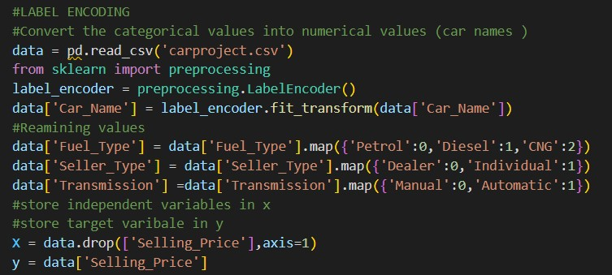
Sample Code

Slide 12
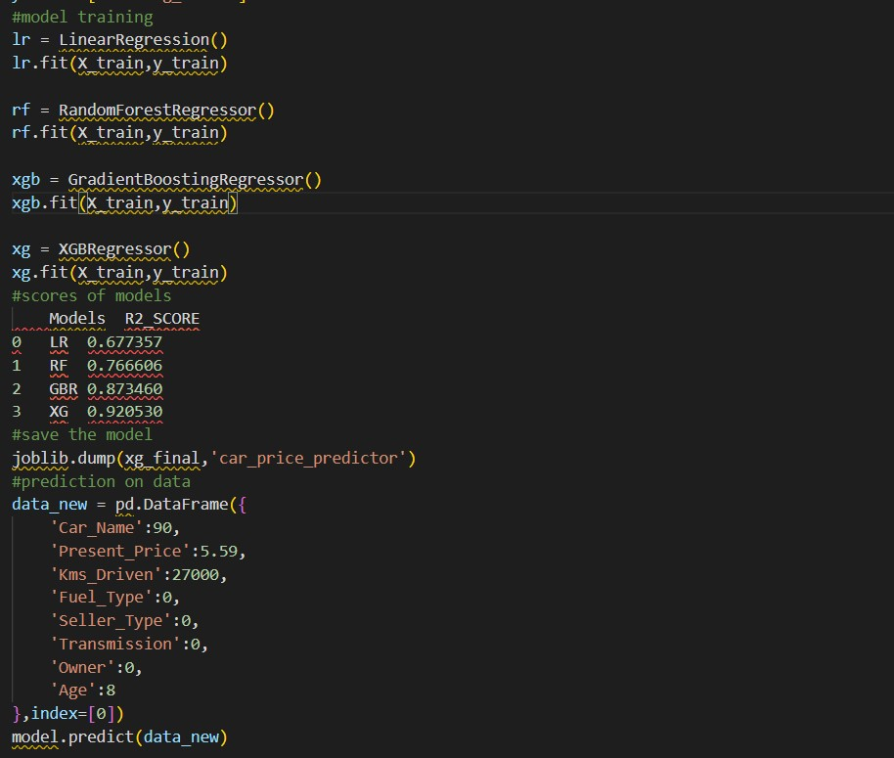
Sample Code

Slide 13
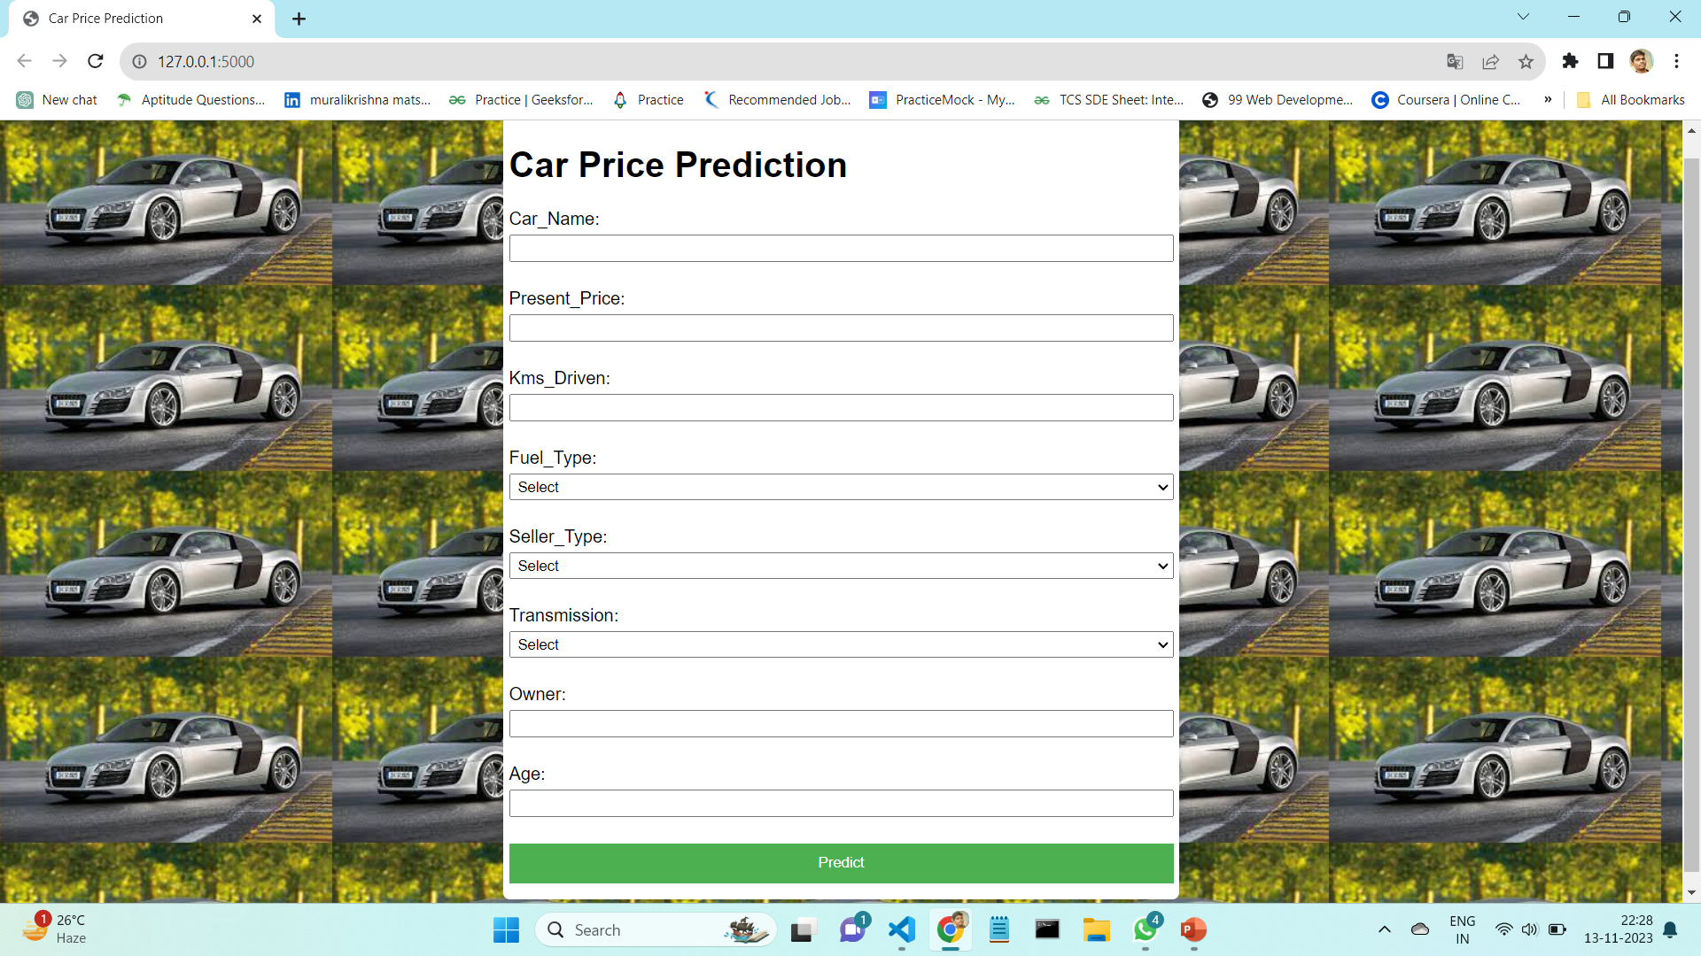
Webpage Preview

Slide 14
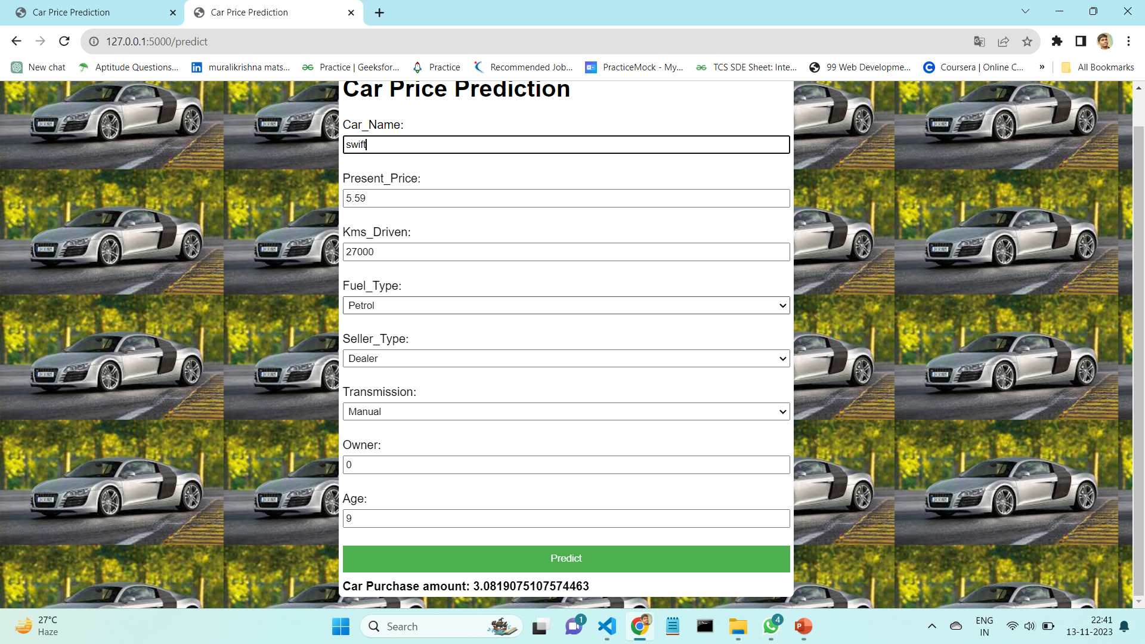
Final Output

Slide 15
CONCLUSION
Predicting used car prices has practical implications for both buyers and sellers in the automotive market.
Our model serves as a valuable decision support tool for users navigating the complex landscape of used car transactions.
The successful implementation of our used car price prediction model has the potential to positively impact the automotive market, aiding both buyers and sellers in making informed decisions.

Slide 16
THANK YOU

